Slide 1
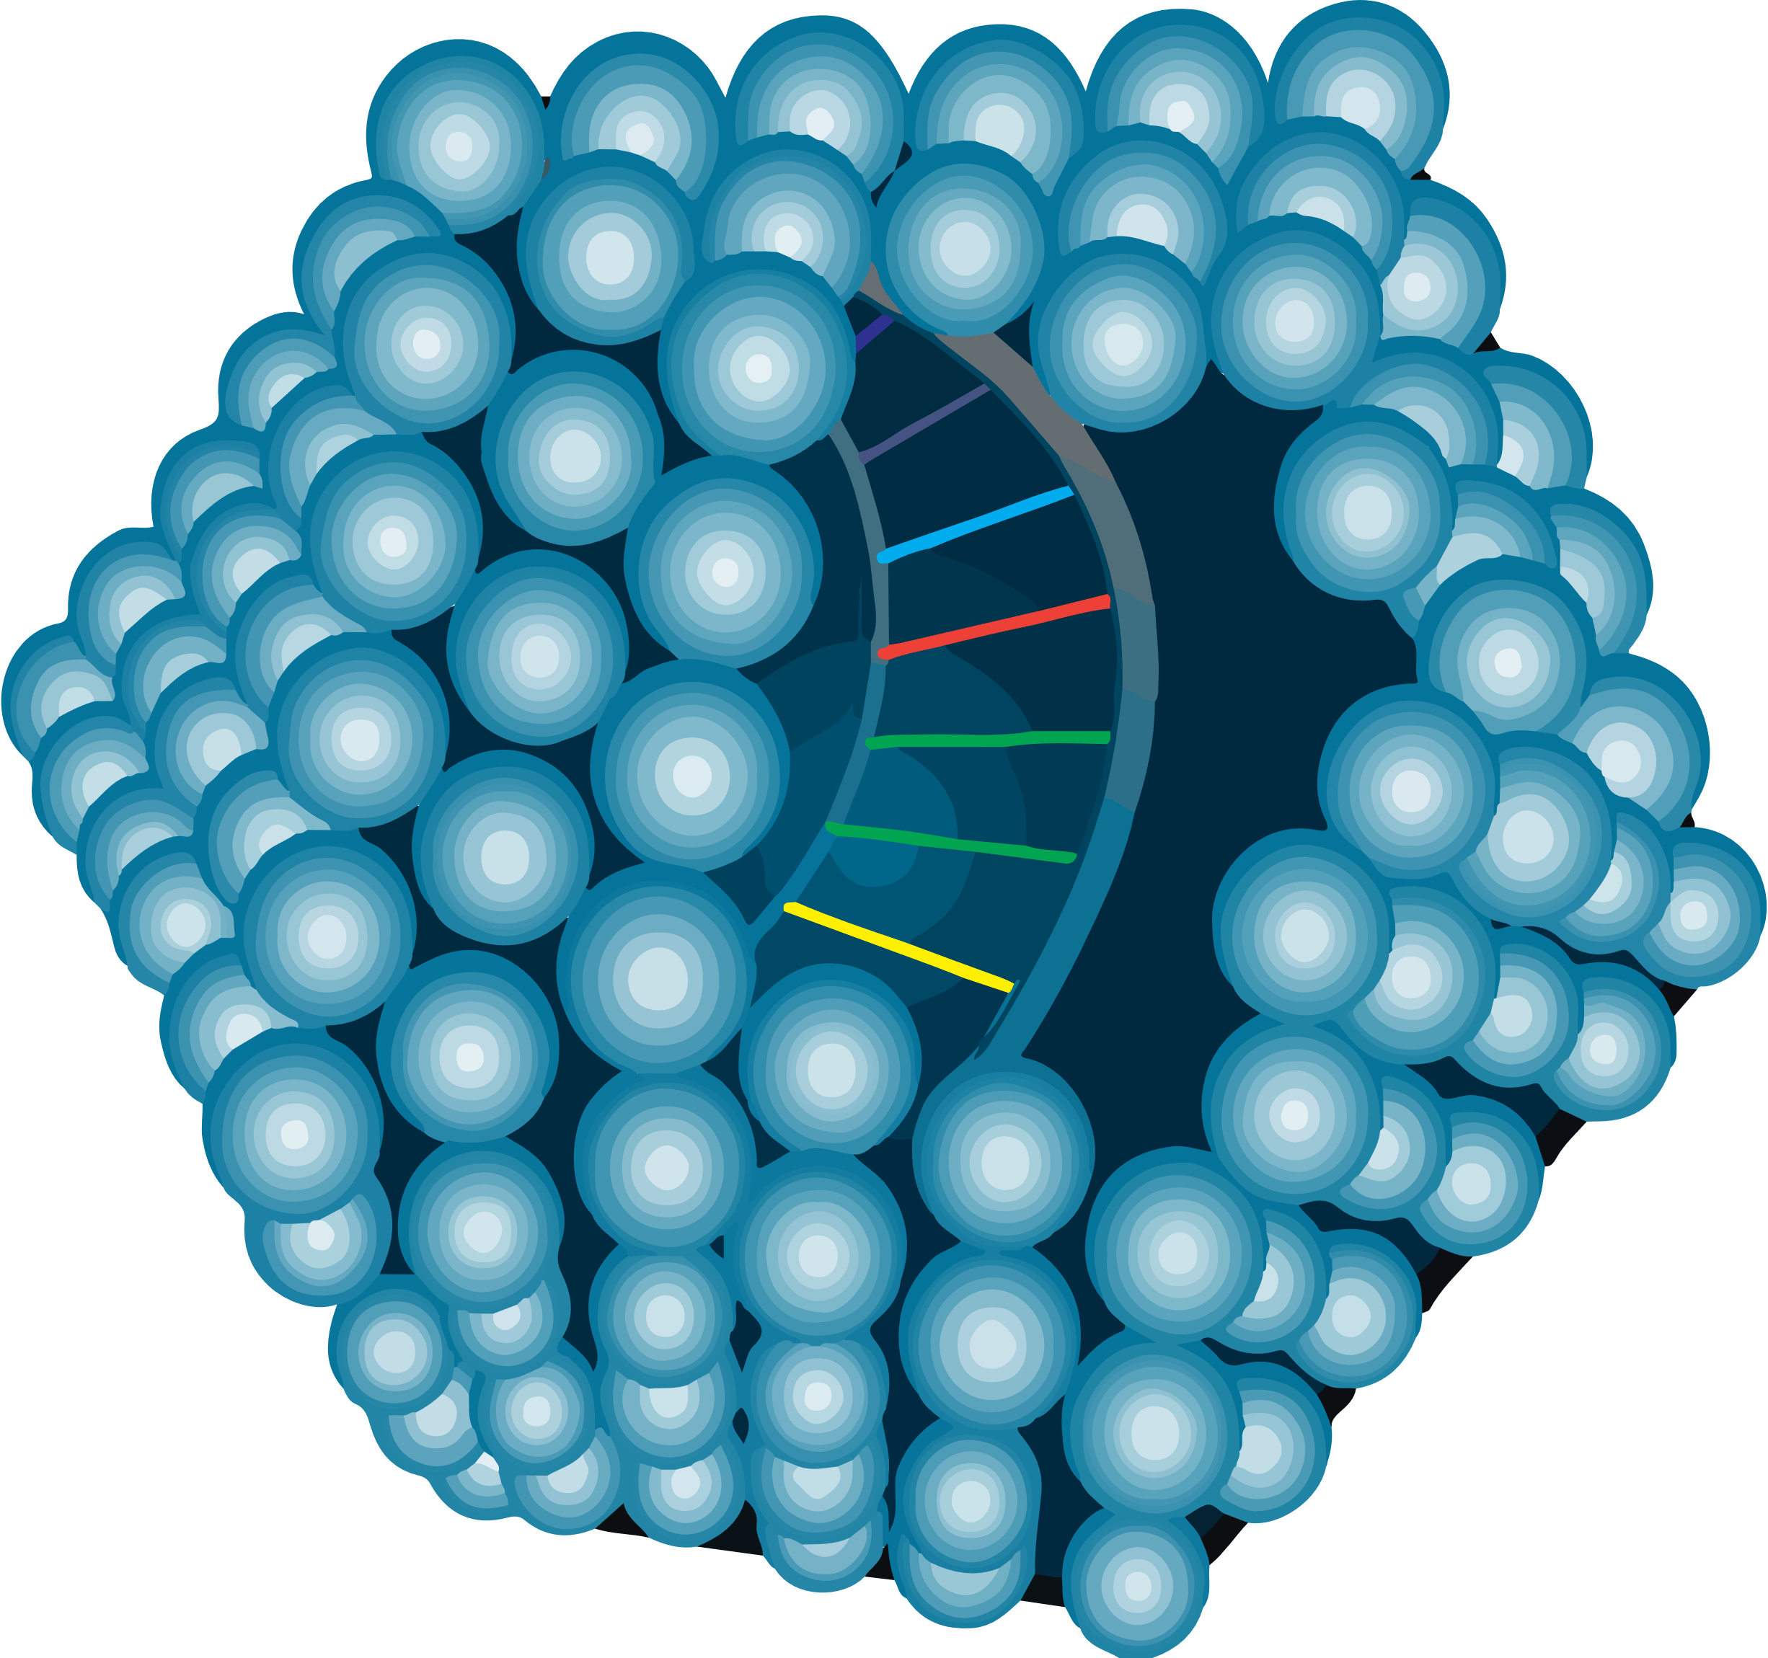
Adults With Severe or Moderately Severe Hemophilia B Receiving Etranacogene Dezaparvovec in the HOPE-B Phase 3 Clinical Trial Continue to Experience a Stable Increase in Mean Factor IX Activity Levels and Durable Hemostatic Protection After 24 Months’ Follow-up
Steven W. Pipe¹, Frank W.G. Leebeek², Michael Recht³, Nigel S. Key⁴, Susan Lattimore⁵, Giancarlo Castaman⁶, Michiel Coppens⁷, David Cooper⁸, Robert Gut⁸, Sergio Slawka⁸, Stephanie Verweij⁸, Ricardo Dolmetsch⁸, Yanyan Li⁹, Paul E. Monahan⁹, Wolfgang Miesbach¹⁰ on behalf of the HOPE-B study investigators
¹University of Michigan, Ann Arbor, MI, USA; ²Erasmus MC, University Medical Center Rotterdam, The Netherlands; ³Yale University School of Medicine, New Haven, CT, USA; ⁴University of North Carolina, Chapel Hill, NC, USA; ⁵Oregon Health & Science University, Portland, OR, USA; ⁶Center for Bleeding Disorders and Coagulation, Careggi University Hospital, Florence, Italy; ⁷Amsterdam UMC location, University of Amsterdam, Vascular Medicine, Amsterdam, The Netherlands and Amsterdam Cardiovascular Sciences, Pulmonary Hypertension & Thrombosis, Amsterdam, The Netherlands; ⁸uniQure BV, Amsterdam, The Netherlands/uniQure Inc. Lexington, MA, USA; ⁹CSL Behring, King of Prussia, PA, USA; ¹⁰University Hospital Frankfurt, Frankfurt, Germany
Introduction
Results
FIX activity
Mean (standard deviation [SD]; min-max) FIX activity levels were sustained for up to 24 months post treatment (Figure 4)
Month 6: 39.0% (±18.7; 8.2–97.1) (n=51)
Month 18: 36.9% (±21.4; 4.5–122.9) (n=50)
Month 24: 36.7% (±19.0; 4.7–99.2) (n=50)
These values represented a significant increase from baseline (mean: 1.19; SD: 0.39) with a least squares mean FIX activity increase of:
Month 6: 36.18% (standard error [SE]: 2.432%; 95% confidence interval [CI]: 31.41–40.95; p <0.0001)
Month 18: 34.31% (SE: 2.444%; 95% CI: 29.52, 39.11; p <0.0001)
Month 24: 34.13% (SE: 2.325%; 95% CI: 29.57, 38.69; p <0.0001; p-value not adjusted for multiplicity)
Safety
The safety profile is consistent with previously presented data¹
Most treatment-emergent AEs (TEAEs) were mild (76.1%; moderate: 20.6%; severe: 3.2%)
93 ​TEAEs in 38/54 participants were treatment related (TRAEs) (Table 2)
Only one TRAE occurred during Months 18–24
Alanine aminotransferase increase (with or without increased aspartate transaminase), reported as an AE, occurred in 11 participants
Nine (16.7%) received supportive care with reactive corticosteroids for a mean duration of 79.8 days (SD: 26.6; range: 51–130 days)
All participants discontinued steroid use prior to Week 26
FIX expression was maintained
No serious AEs related to treatment
One death was reported, unrelated to study treatment
A 75-year-old participant died from cardiogenic shock (at ~15 months following infusion), preceded by a urinary tract infection​
One case of hepatocellular carcinoma (previously reported) – unrelated to study treatment following a detailed molecular analysis³
Etranacogene dezaparvovec (formerly AMT-061), an investigational gene therapy for hemophilia B, is an adeno-associated virus serotype 5 (AAV5) vector, containing a codon-optimized, highly active factor IX (FIX) Padua R338L transgene under the control of a liver-specific promoter (Figure 1)​
The Phase 3 HOPE-B clinical trial (NCT03569891) of etranacogene dezaparvovec met its primary efficacy endpoint, providing hemostatic protection superior to standard of care FIX prophylaxis over 52 weeks of follow-up after stable FIX Padua expression (defined as Months 7–18)^{1,2}
However, the potential for liver-directed AAV to sustain long-term clotting factor expression remains unknown, with most human experience derived from early phase clinical trials
Study participants
Of the 54 participants who received etranacogene dezaparvovec (Table 1):
53 participants received the full dose
One only received a partial dose (due to an infusion-related reaction)
52 completed 24 months of follow-up
Table 1. Baseline demographics
 | Full analysis set, N=54
Age, mean (SD, min–max), years | 41.5 (15.8, 19–75)
Severity of HB at diagnosis, n (%) Severe (FIX <1%) Moderately severe (FIX ≥1% and ≤2%) | 44 (81.5) 10 (18.5)
Positive HIV status, n (%) | 3 (5.6)
Prior hepatitis B infection, n (%) | 9 (16.7)
Prior hepatitis C infection, n (%) | 31 (57.4)
Pre-screening FIX treatment, n (%) Extended half-life Standard half-life | 31 (57.4) 23 (42.6)
Detectable AAV5 NAbs at baseline, n (%) | 21 (38.8)
Participants with zero reported bleeds at lead-in period, n (%) | 14 (25.9)
Figure 1. Etranacogene dezaparvovec
Figure 4. FIX activity levels over 24 months
AMT-061
125
Min/max^{b}
Q1–Q3
Mean
Median
Individual data point^{b}
AAV5
100
75
Table 2. Most common TRAEs (incidence >5%)
 | Post-treatment Period​ (N = 54)​
 | Participants, n (%)​ | Events, n​
ALT increased​ | 9 (16.7)​ | 10​
Headache​ | 8 (14.8)​ | 9​
Influenza-like illness​ | 7 (13.0)​ | 8​
AST increased​ | 5 (9.3)​ | 6​
Blood CPK increased​ | 4 (7.4)​ | 6​
Dizziness​ | 4 (7.4)​ | 4​
Fatigue​ | 4 (7.4)​ | 4​
Nausea​ | 4 (7.4)​ | 4​
Arthralgia​ | 3 (5.6)​ | 3​
Infusion-related reaction​ | 3 (5.6)​ | 3​
One-stage aPTT FIX activity (%)
50
25
LP-1 (Liver-specific promoter)
Human wild-type FIX (codon optimized) with 2 nucleotide adaptation
0
M24
Baselineª
W3
W4
W5
W6
W7
W8
W9
W10
W11
W12
M4
M5
M6
M7
M8
M9
M10
M11
M12
M18
Number of
participants
with data
54
43
49
51
Time (week)
Time (month)
Padua variant
AAV5, adeno-associated virus 5; FIX, factor IX; HB, haemophilia B; HIV, human immunodeficiency virus; NAbs, neutralizing antibodies; SD, standard deviation.
47
46
48
46
44
46
51
48
45
51
47
45
51
50
50
50
50
50
AAV, adeno-associated virus; FIX, factor IX.
ª Baseline FIX was imputed based on participant’s historical hemophilia B severity documented on the CRF. If the participant had documented severe FIX deficiency (FIX<1%), their baseline FIX activity level was input as 1%. If the participant had documented moderately severe FIX deficiency (FIX≥1% and ≤2%), their baseline FIX activity level was input as 2%. The standard error was not provided at baseline.
^{b} Min/max within 1.5x interquartile range of the bottom and top of the box, respectively. Any points outside of the whiskers are plotted individually. aPTT, activated partial thromboplastin time; CRF, case report form; FIX, factor IX; M, Month; W, Week.
Aim
ABR
Compared with the ≥6-month lead-in period, mean ABR for all bleeds during Months 7–24 post-treatment was significantly reduced by 64% (Figure 3)
Mean ABR lead-in period vs Months 7–24: 4.19 vs 1.51; p=0.0002
The bleed reduction that satisfied the primary endpoint of the trial during Months 7–18 was sustained for Months 7–24
Mean ABR for all other bleed types was reduced at Months 7–24 compared with the ≥6-month lead-in period
To present updated efficacy and safety data from the pivotal Phase 3 HOPE-B clinical trial over 24 months’ follow-up
FIX replacement product use
Use of FIX replacement product was significantly decreased from baseline
There was a 96% reduction in mean unadjusted annualized FIX consumption from the lead-in period to Months 19–24 (Figure 5)
Of the 54 participants, 52 (96.3%) discontinued and remained free of continuous FIX prophylaxis from Day 21 to Month 24, including 20 participants with baseline AAV5 NAb titers up to 1:700
One participant with a markedly higher AAV5 NAbs titer (1:3212) and one participant who received only a partial vector dose (due to an infusion-related reaction) did not express FIX Padua or discontinue FIX prophylaxis
Methods
Open-label, single-dose, single-arm, international trial (NCT03569891)² in adult males with severe or moderately severe hemophilia B (FIX activity ≤2% of normal) on routine FIX prophylaxis (for ≥2 months), with/without pre-existing AAV5 NAbs (Figure 2)
Participants were infused with a single dose of etranacogene dezaparvovec (2x10¹³ gc/kg), following a ≥6-month lead-in period receiving FIX prophylaxis
FIX activity, annualized bleed rate (ABR), and FIX infusions were assessed frequently during the ≥6 months lead-in period (when FIX prophylaxis was received) and first 12 months after receiving etranacogene dezaparvovec, then every 6 months during the long-term follow-up (Years 2–5)
Adverse events (AEs) were continuously assessed
CPK, creatine phosphokinase; ALT, alanine transaminase; AST, aspartate transaminase; TRAE, treatment-related adverse event.
Figure 3. Improvement in ABR
Conclusions The HOPE-B study demonstrates that etranacogene dezaparvovec can provide durability of disease correction with acceptable safety up to 24 months’ in people with hemophilia B After 24 months following a single dose of etranacogene dezaparvovec Stable FIX Padua expression was observed in participants with AAV NAb undetected or <1:700 titer Reductions in ABR remained durable and superior to FIX prophylaxis All participants who discontinued prophylaxis remained off prophylaxis Safety profile was consistent with previous reports with limited early reactive corticosteroid exposure in a minority of participants
Figure 2. HOPE-B study design
Figure 5. FIX replacement product use
Screening
≥6-month lead-in period
Etranacogene dezaparvovec administration
Post-treatment
follow-upª
64% reduction in ABR (all bleeds)
p=0.0002
73% reduction in treated bleeds
p=0.0001ª
From lead-in period to Months 19–24: 96% reduction (p<0.0001) in mean unadjusted annualized FIX consumptionª
SOC continuous FIX prophylaxis
2x10¹³ gc/kg dose
Weekly visits
Monthly visits
Twice-yearly visits
75% reduction in ASBR
p=0.0005
80% reduction in AJBR
p<0.0001
No prophylactic
immunosuppression
Primary efficacy endpoint (Months 7–18)
Acknowledgments
The HOPE-B study was sponsored by uniQure Inc. and CSL Behring.
Editorial assistance was provided by Chrysalis Medical Communications, a part of Nucleus Global, funded by CSL Behring.
0
1
12
26
1
1.5
5
8,399
References
1. Miesbach W, et al. Oral presentation at EAHAD 2021; OR014
2. Clinicaltrials.gov identifier: NCT03569891. Available at: https://clinicaltrials.gov/ct2/show/NCT03569891. Accessed November 2022
3. Schmidt M, et al. Oral presentation at ISTH 2021; OC 67.4
Weeks
Years
Lead-in
period
Months
0–6
Months 7–12
Months 13–18
Months
19–24
ª At least quarterly contact (±2 weeks) between site staff and subjects to monitor occurrence of adverse events. Last subject visit planned Q1 2025. ABR, annualized breeding rate; FIX, factor IX; gc/kg, genome copies/kilogram; SOC, standard of care.
ª P-value for treated bleeds is not Type I error controlled.
ABR, annualized bleeding rate; AJBR, annualized joint bleeding rate; ASBR, annualized spontaneous bleeding rate.
ª Error bars represent standard deviation. FIX, factor IX; IU, international unit.​
Presented at the 64th American Society of Hematology (ASH) Annual Meeting and Exposition, 10–13 December 2022.
Abstract
2141

